Slide 1
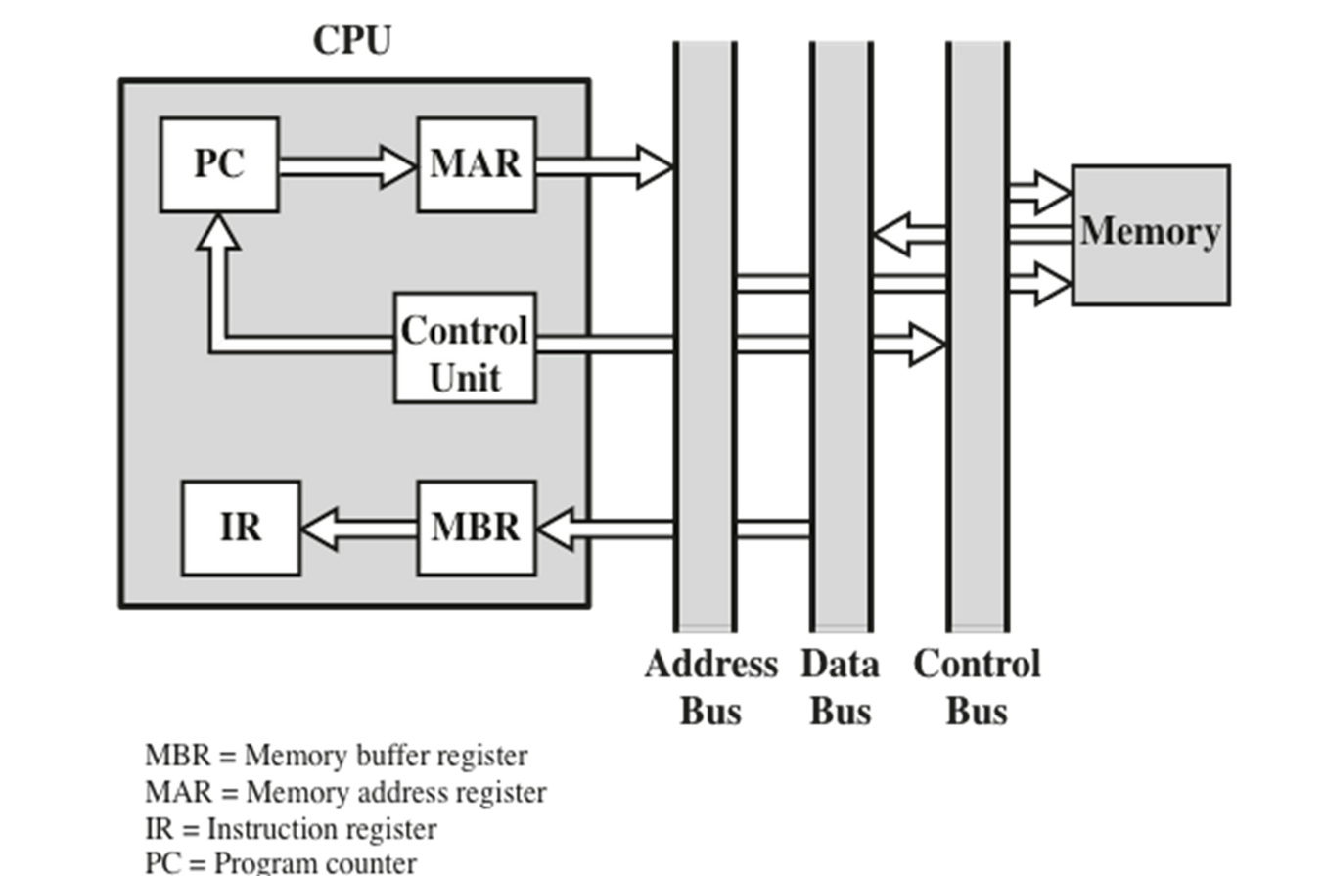
Data Flow, Fetch Cycle

Slide 2
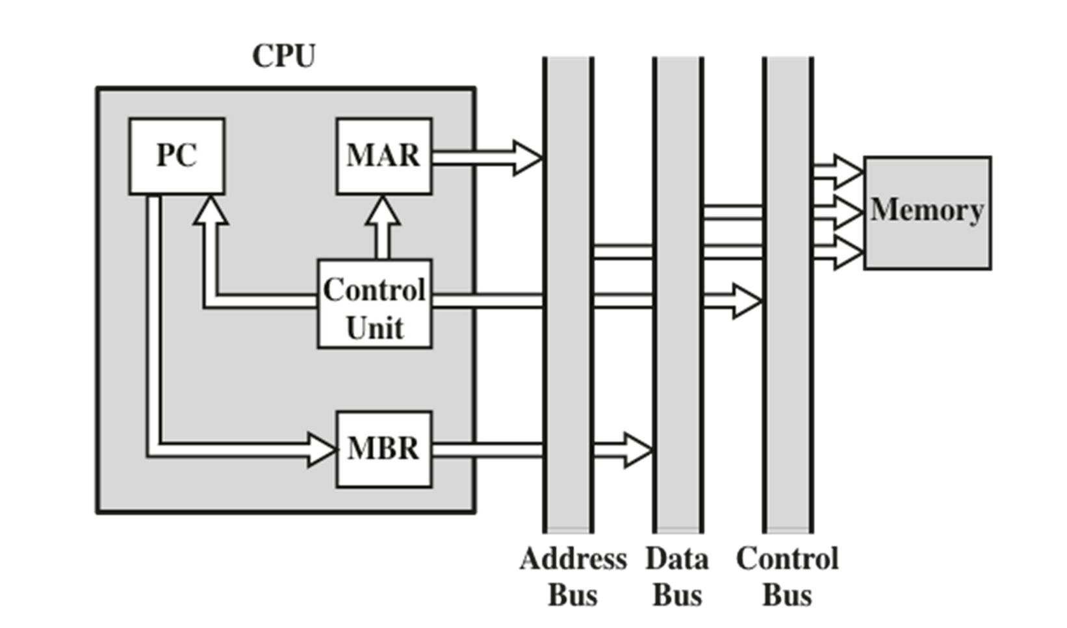
Data Flow, Interrupt Cycle

Slide 3
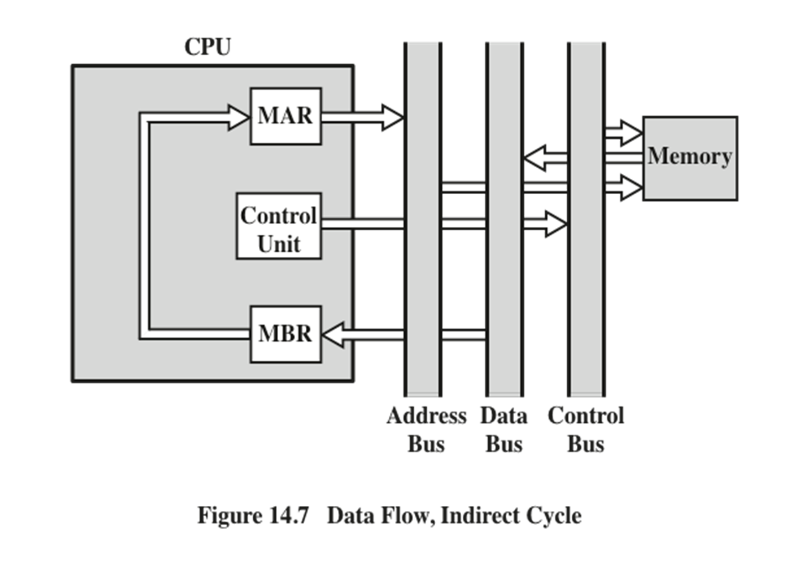
Data Flow, Indirect Cycle

Slide 4

Additional Stages
Fetch instruction (FI)
Decode instruction (DI)
Calculate operands (CO)
Fetch operands (FO)
Execute instruction (EI)
Write operand (WO)

Slide 5
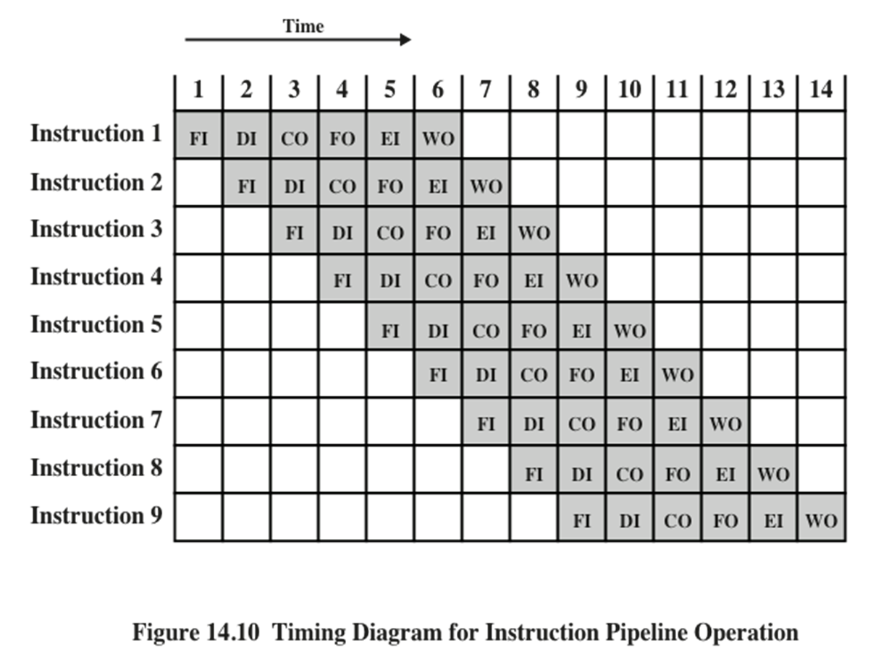
Timing Diagram for Instruction Pipeline Operation

Slide 6
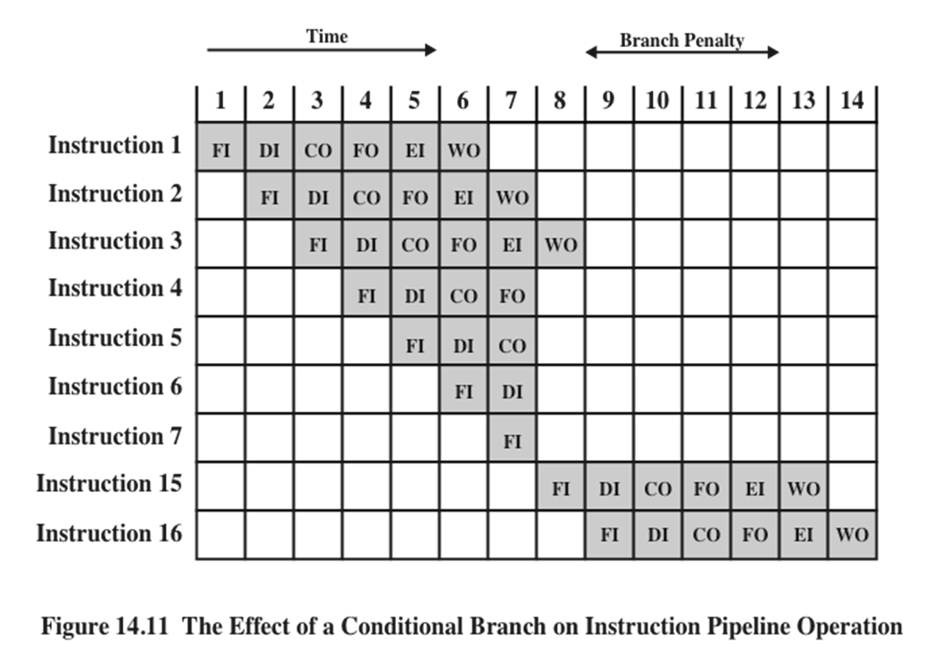
The Effect of a Conditional Branch on Instruction Pipeline Operation

Slide 7
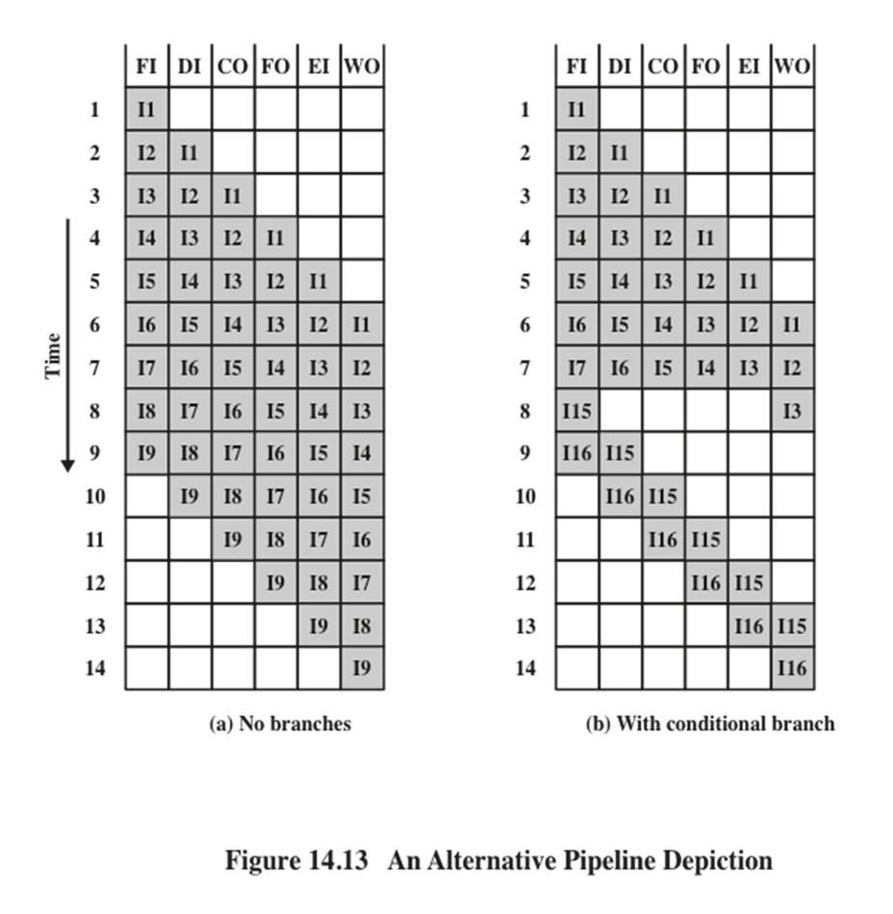
Alternative Pipeline Depiction

Slide 8
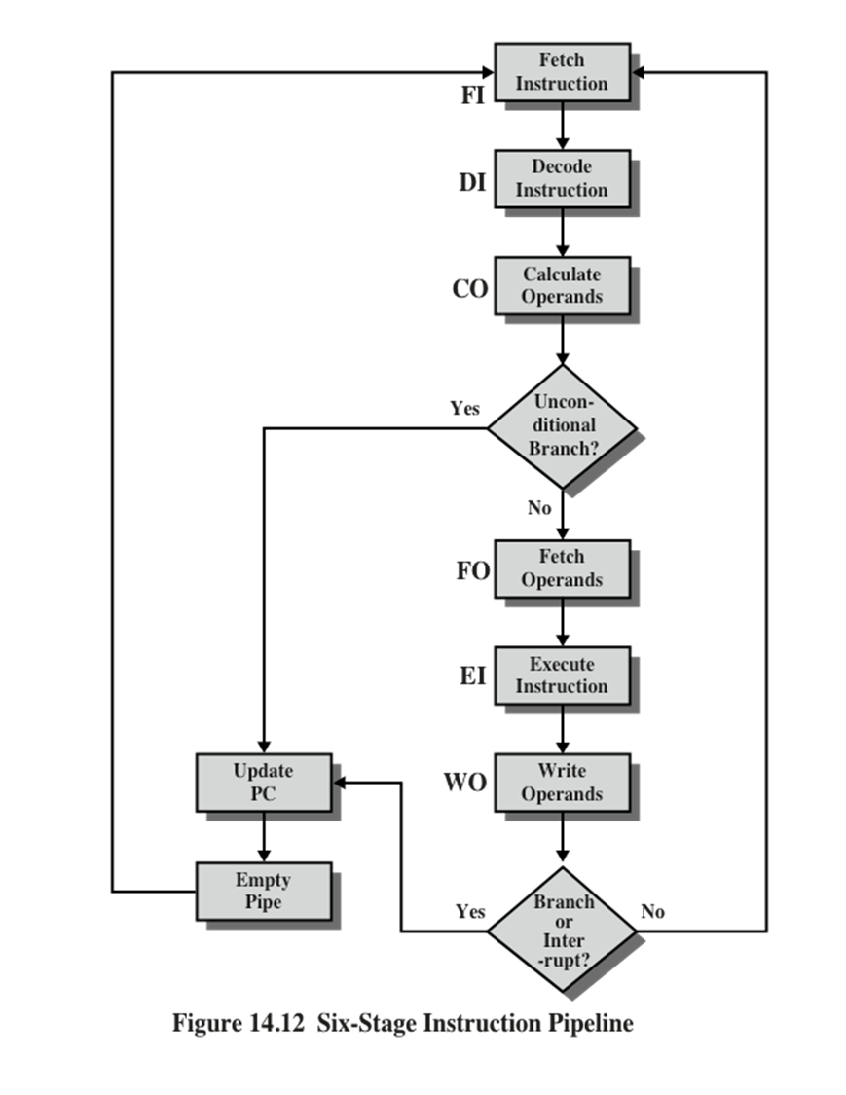
Six Stage CPU Instruction Pipeline

Slide 9
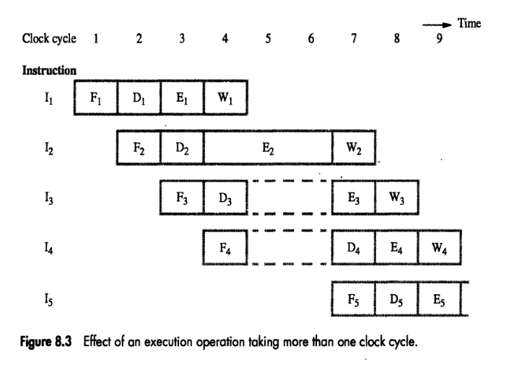
Types of hazards
2) Data Hazard
A Data Hazard occurs when there is a conflict in the access of an operannd location.
Three Types of Data Hazard
1)Read after write (RAW), or true dependency
2)Write after read (WAR), or anti dependency.
3)Write after write (WAW), or output dependency

Slide 10
Types of hazards
3) Control Hazard
The Control Hazard also known as a branch hazard.
It occurs when the pipeline makes the wrong decision on a branch prediction.

Slide 11
Pipeline
What is a pipeline in a CPU?
Pipelining is a technique for breaking down a sequential process into various sub-operations and executing each sub-operation in its own dedicated segment that runs in parallel with all other segments.
The dependencies in the pipeline are referred to as hazards since they put the execution at risk.
A hazard, in essence, prevents an instruction present in the pipe from being performed during the specified clock cycle. Since each of the instructions may be in a separate machine cycle, we use the term clock cycle.

Slide 12
Structural Hazard: Conflicts among pipeline instructions due to simultaneous resource usage, such as memory, registers, or ALU.
Data Hazards: Dependencies between instructions in a pipeline caused by incomplete execution of preceding instructions.
Control Hazards: Arise from branch instructions, impacting the flow of program execution in pipelined architectures.
Design of a basic pipeline. In a pipelined processor, a pipeline has two ends, the input end and the output end. Between these ends, there are multiple stages/segments such that the output of one stage is connected to the input of the next stage and each stage performs a specific operation.Interface registers are used to hold the intermediate output between two stages. These interface registers are also called latch or buffer. All the stages in the pipeline along with the interface registers are controlled by a common clock.

